Slide 1

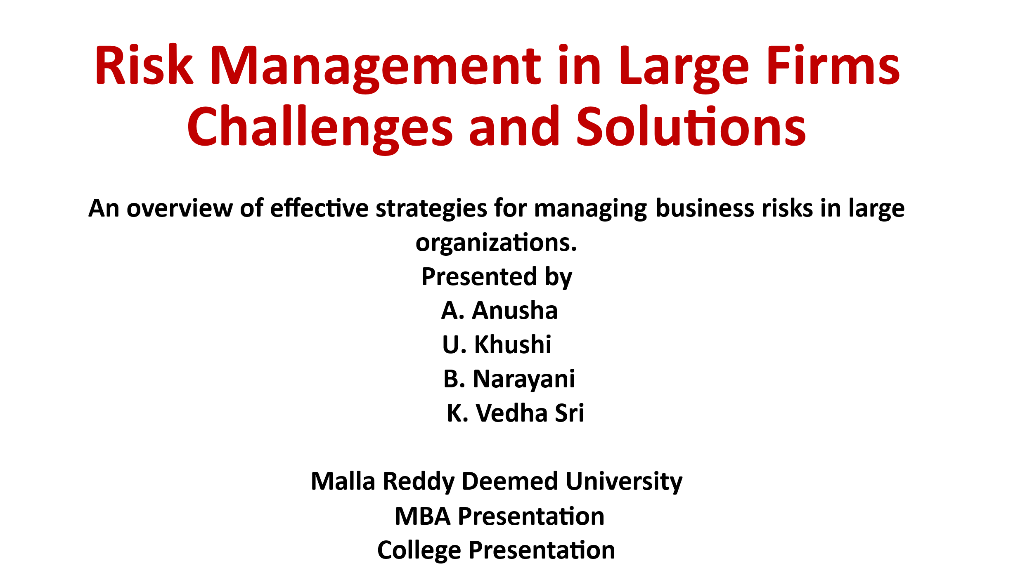

Slide 3
Introduction
- Large firms face challenges due to their size, complex structures, and global operations.
- Managing multiple departments, ensuring clear communication, controlling finances, and keeping employees motivated can be difficult.
- Risk management helps identify potential problems early, reduce losses, and improve overall efficiency.

Slide 4
Objective
- Identify the main problems faced by large firms.
- Suggest practical solutions through risk management.
- Show how technology, communication, and teamwork can improve efficiency.
- Highlight the importance of compliance, employee motivation, and social responsibility.

Slide 5
Problems Faced By Large Firms
1. Complex Organizational Structure
2. Communication Gaps
3. Financial and Operational Challenges
4.Reaucracy and Red Tape
5. Employee Management Issues

Slide 6

Solutions For Problems Faced By The Large Firms
1.Smplify the Structure
2. Improve Communication
3. Control Finances.
4. Reduce Bureaucracy
5. Motivate Employees
6. Use New Technology
7. Work as One Team
8. Stay Ahead in Competition

Slide 7
Case Study: JPMorgan Chase – The “London Whale” Trading Loss (2012)
Background
for risk management analysis in large financial firms. JPMorgan Chase, one of the largest banks in the world, faced a massive trading loss in 2012, famously called the “London Whale” incident. A trader in their Chief Investment Office (CIO) in London made complex derivatives trades that resulted in a loss of $6.2 billion.
The case is significant
Risks Identified
Market Risk: Exposure to large and complex credit derivatives with high volatility.
Operational Risk: Lack of sufficient oversight and internal controls on trading activities.
Reputational Risk: Loss of public trust and media scrutiny.
Regulatory Risk: Potential violations of financial regulations, leading to fines.
Financial Risk: Unexpected losses impacting the firm’s balance sheet.

Slide 8
Risk Management Failures
Underestimation of Risk Exposure: The bank underestimated potential losses from complex trades.
Inadequate Internal Controls: Risk management systems did not flag unusual trading positions in real time.
Overconfidence in Hedging: The CIO assumed trades were hedged, but the hedges were ineffective.
Delayed Escalation: Alerts raised by risk officers were not acted upon promptly.

Slide 9
OUTCOMES:
Financial loss: $6.2 billion; JPMorgan paid $920 million in fines and settlements.
Reputation: Highlighted weaknesses in risk management of even the largest banks.
Operational Change: JPMorgan strengthened its risk systems and governance structures, becoming a case study in proactive vs. reactive risk management.

Slide 10
Conclusion: The “London Whale” case shows that risk management in large firms is complex and multifaceted. Even well-capitalized, global firms can face massive losses if risks are underestimated, controls are weak, or culture ignores caution. Effective risk management involves people, processes, and technology working together.

Slide 11


